Slide 1
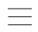
嘉大好課評價系統
哪個教授好？
第15組
資工三甲 1102914 龔弋筠
資工三甲 1102916 游雅碩
資工三甲 1102926 洪唯翔
資工三甲 1102936 黃建澄

Slide 2
大綱
項目架構
01.
各項目細項
02.
功能說明
03.
資料庫說明
04.
使用套件
05.
DEMO
06.

Slide 3
項目架構
嘉大好課評價系統
帳號管理模組
課程爬蟲 (匯入功能) 模組
課程評價模組
統計模組

Slide 4
項目架構
嘉大好課
評價系統
帳號管理模組
課程爬蟲 (匯入功能) 模組
課程評價模組
統計模組

Slide 5
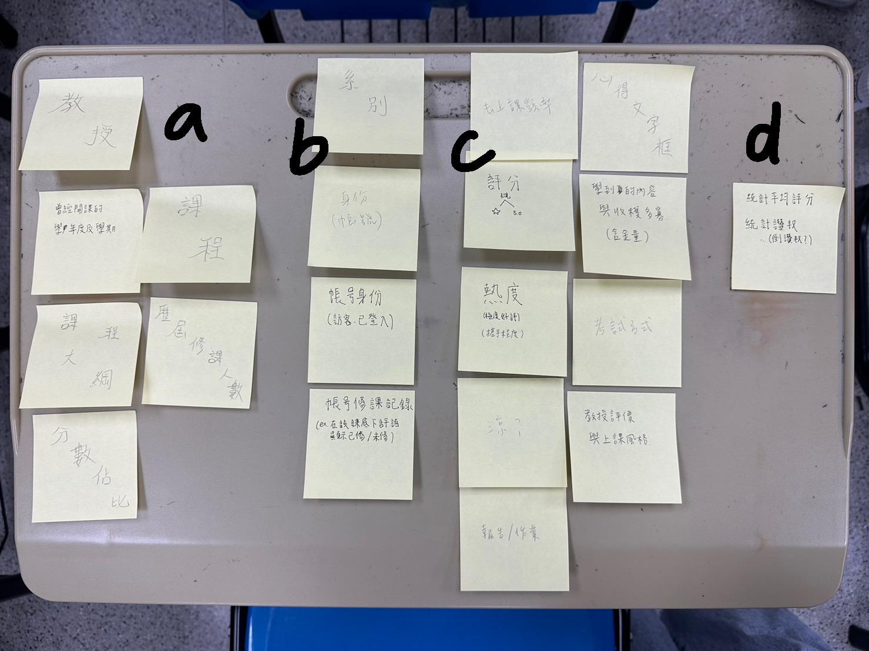
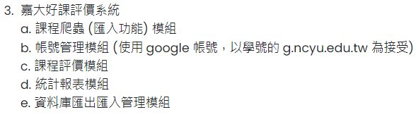

Slide 6
a. 課程爬蟲 (匯入功能) 模組
自編序號
曾經開課學年度、學期
教授
課程大綱
分數占比
歷屆修課人數
必修選別(必選修)
學分

Slide 7
b. 帳號管理模組
(使用 google 帳號，以學號的 g.ncyu.edu.tw 為接受)
系別
身分(已訪客/學生)
修課紀錄(修/未修)

Slide 8
c. 課程評價模組
哭阿又被當
去上課頻率
評分
熱度
涼度
報告/作業
心得
收穫多寡
考試方式
教授評價與上課風格
是否通過？

Slide 9
WEEK 2
基礎功能
自增功能
資料庫架構
Schema
使用套件

Slide 10
期末專題規劃與初步成果 DEMO
1. 功能說明
A. 基礎功能
B. 自增功能
2. 資料庫說明
A. SCHEMA 說明
3. 使用套件
A. Bootstrap
B. Jquery
C. Laravel (可用)
D. 其他框架不建議

Slide 11
基礎功能
帳號登入
帳號資料、身分設定
課程列表
課程頁面－課程資料、收集評分資料
學生評分頁面

Slide 12
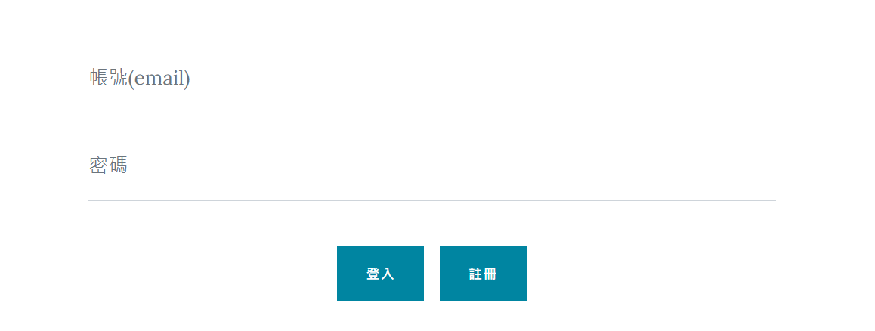
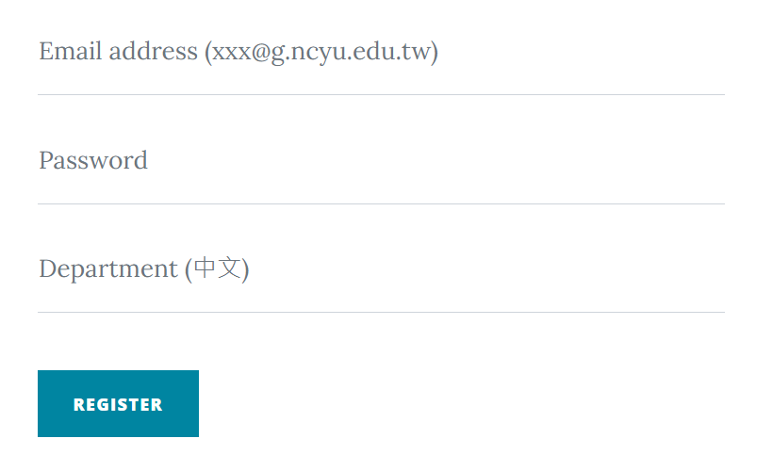
帳號登入與註冊
有格式限制
科系規定只能打中文

Slide 13

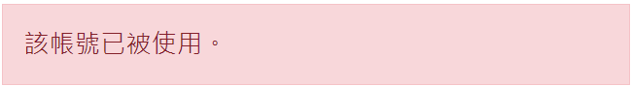
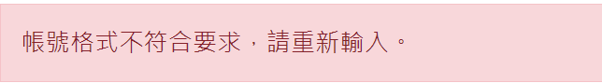
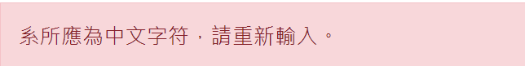
帳號登入與註冊
註冊錯誤提示
註冊成功跳至登入頁面
登入成功跳至首頁

Slide 14
課程列表、學生評分頁面

Slide 15
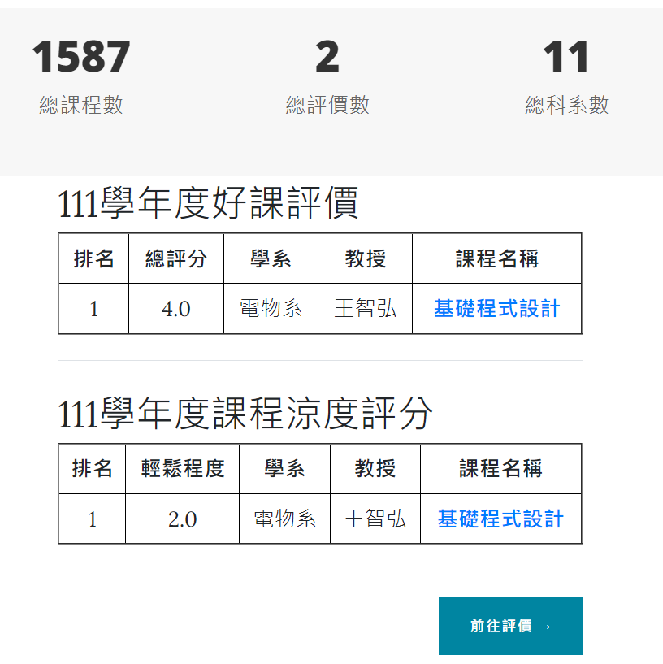
自增功能
分為訪客/登入身分，給予不同的使用權限
對評分的內容作分類跟整理
讓學生在察看課程評價時有更清楚簡要的介面
統計每學期最涼/最硬及評分課程前3名（做排名）

Slide 16
自增功能

Slide 17
資料庫架構
course
c_id
c_num 永久課號
c_college 學院
c_department 科系
c_name 課程名稱
c_pro 授課教師
c_grade 適用年級
c_people 選上人數
c_required 課程修別
c_credit 學分數
c_year 學年度
c_semester 學期

Slide 18
資料庫架構
account
a_id
a_mail
a_password
a_department 系別

Slide 19
資料庫架構
evaluate
e_id
e_account 評價的學生帳號
e_course 課程
e_score 課程評分
e_easy 涼/硬
e_test 考試
e_report_HW 報告作業
e_gain 收穫
e_pro 教授、上課方格評價
e_exprience 心得
e_fre 到課頻率
e_pass 是否通過

Slide 20
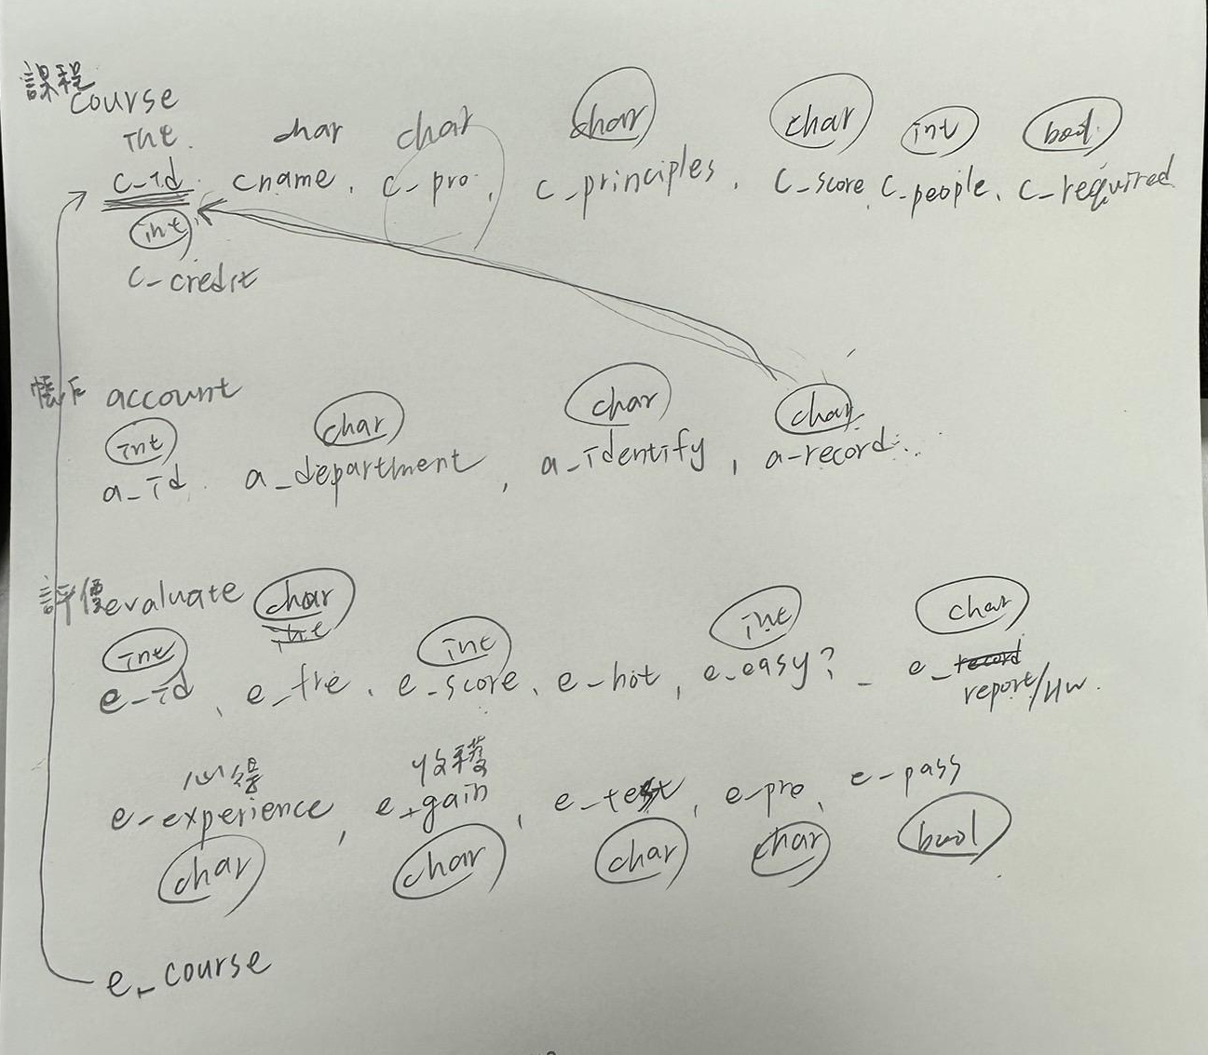
資料庫Schema

Slide 21
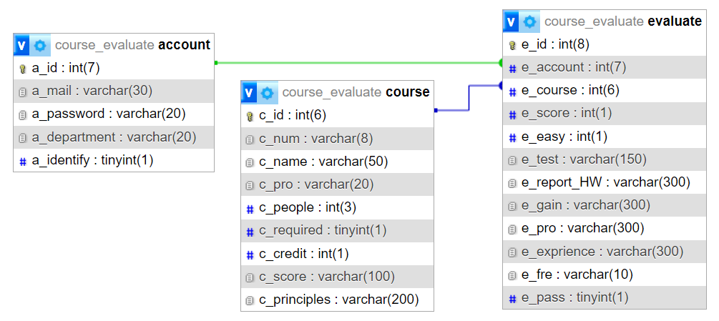
資料庫Schema

Slide 22
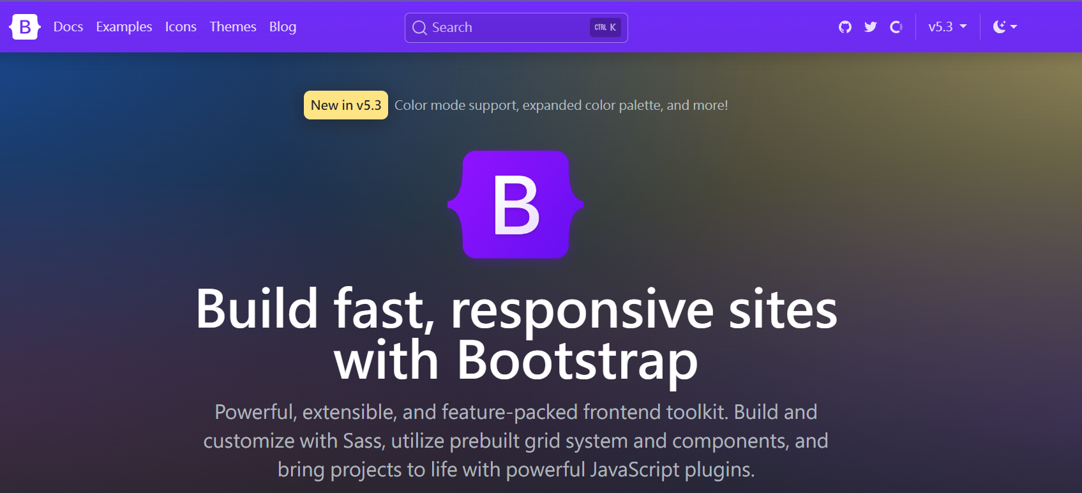
使用架構
Bootstrap

Slide 23
工作分配
實作
PPT
報告
爬蟲-洪唯翔、黃建澄
帳號登入及註冊-洪唯翔
資料庫-龔弋筠、游雅碩
課程列表、評價-龔弋筠、游雅碩
首頁-黃建澄
初報告-龔弋筠、游雅碩、洪唯翔
期末報告-游雅碩
第一次-洪唯翔、龔弋筠
第二次-游雅碩、黃建澄

Slide 24
DEMO

Slide 25
WEEK 3
傳000web
建立主頁面
完成資料庫
爬蟲
評價頁面

Slide 26
WEEK 4
完成主頁面
課程列表頁面
登入/註冊
完善評價

Slide 27
Cybersecurity consulting report infographics
Good practices to protect your equipment
Use strong passwords
Shop on trusted websites
Venus has a beautiful name, but also very high temperatures
Despite being red, Mars is actually a very cold place
Use secure payments
Use trusted networks
Mercury is the closest planet to the Sun and the smallest of them all
Jupiter is a gas giant and the biggest planet of them all
Beware of spam email
Beware of suspicious links
Earth is the third planet from the Sun and harbors life
Saturn is composed mostly of hydrogen and helium
This template has been created by Slidesgo

Slide 28
下周進度
01
02
03
04
05
06
Introduction
Problem & solution
Market opportunity
Product demo
Team & timeline
Financial & metrics

Slide 29
Contents of this template
You can delete this slide when you’re done editing the presentation
Fonts | To view this template correctly in PowerPoint, download and install the fonts we used
Used and alternative resources | An assortment of graphic resources that are suitable for use in this presentation
Thanks slide | You must keep it so that proper credits for our design are given
Colors | All the colors used in this presentation
Icons and infographic resources | These can be used in the template, and their size and color can be edited
Editable presentation theme | You can edit the master slides easily. For more info, click here
For more info: SLIDESGO | BLOG | FAQs
You can visit our sister projects: FREEPIK | FLATICON | STORYSET | WEPIK | VIDEVO

Slide 30
Table of contents
01
02
03
04
05
06
Introduction
Problem & solution
Market opportunity
Product demo
Team & timeline
Financial & metrics

Slide 31
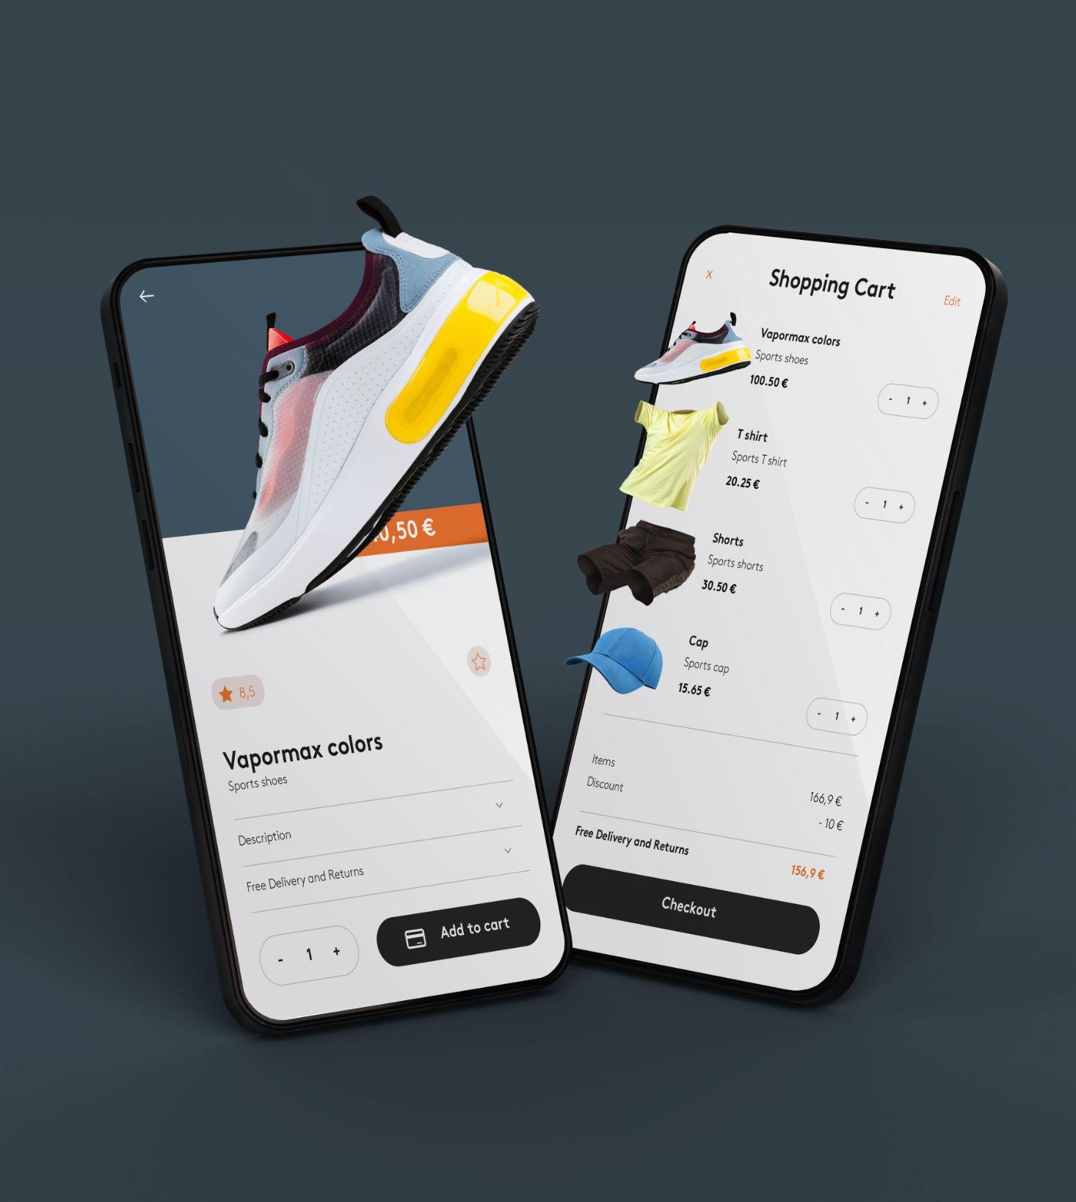
What is a pitch deck?
A pitch deck is a short presentation that entrepreneurs use to describe their business and present it to potential investors. It usually consists of about 10 slides with:
An overview of the company's mission and the product or service offered
Market opportunity
Team, financials, etc.
The goal is to garner enough interest from investors so that they are motivated to invest in the business

Slide 32
Introduction
Our company
Our idea
The introduction of your company in the pitch deck should include a brief overview of who you are and what you do. It should also include a brief description of why your product or service is unique and the value it provides to customers
The “our idea” part of a pitch deck should include an explanation of your product/service, how it works, and what the customer value is. You should also explain the market opportunity for your product/service

Slide 33
Main ideas of a pitch deck
Presentation
Investors
Value
A great presentation for a pitch deck should be concise, clear and easy to understand. Visual elements such as charts, graphs, images, and videos can help to make the presentation engaging
When it comes to picking investors for a pitch deck, it's important to research potential investors and understand their preferences, goals
and interests
The value of a product is determined by how much customers are willing to pay for it. It's a combination of factors, including the quality of the product, its features, and how well it meets customer needs

Slide 34
Key ideas in market opportunity
Research new markets
Innovative solutions
Analyze existing customer needs and identify gaps in the market to find new opportunities
Utilize technology and customer feedback to come up with novel solutions that meet your customer’s demands or needs
Stay ahead of trends
Seasonal spikes
Monitor changes in the marketplace, such as shifts in consumer behavior or emerging technologies, to stay competitive and capitalize on new opportunities and trends
Identify times of year when demand for certain products may spike, such as holidays or special occasions, and use these times to target customers or maximize sales

Slide 35
Six recommendations
Keep it simple
Use visuals
Keep it short
Structure your pitch deck clearly and make sure all the important points are easy
to understand
Incorporate visuals or graphics to illustrate your message and keep the audience engaged
A good pitch deck should be concise and clear; avoid trying to cram in too much information
Make it memorable
Test & iterate
Main points
Include impactful stories, statistics, or facts that will help your audience remember your message afterwards
Practice presenting your deck beforehand with friends or colleagues for feedback, then use this input to refine
it further
A pitch deck is an overview of your business; focus on key points that get the most important ideas across

Slide 36
Cybersecurity consulting report infographics
Cyber attacks during XXXX
January · Name
May · Name
Sept. · Name
Mercury: Mercury is the closest planet to the Sun
Mars: Despite being red, Mars is actually a cold place
Earth: Earth is the third planet from the Sun and has life
Feb
Apr
Jun
Aug
Oct
Dec
Jan
Mar
May
Jul
Sep
Nov
April · Name
July · Name
Nov. · Name
Venus: Venus is the second planet from the Sun
Jupiter: Jupiter is the biggest planet of them all
Saturn: Saturn is a gas giant and has several rings
This template has been created by Slidesgo

Slide 37
Cybersecurity consulting report infographics
Cybersecurity management process
Preparation
First section
Fourth section
Recovery
Mercury is the closest planet to the Sun
Jupiter is the biggest planet of them all
Venus is the second planet from the Sun
Earth is the third planet from the Sun
Detection
Second section
Third section
Action
Despite being red, Mars is a cold place
Neptune is the farthest planet from the Sun
Pluto is now considered a dwarf planet
Ceres is located in the main asteroid belt
This template has been created by Slidesgo

Slide 38
Cybersecurity consulting report infographics
Monthly cybersecurity roadmap
01.
Mars: Mars is a very cold place
A
02.
Mercury: It’s the closest planet to the Sun
03.
Venus: It’s the second planet from the Sun
B
04.
Earth: It’s the only planet that harbors life
05.
Jupiter: It’s the biggest planet of them all
C
06.
Saturn: Saturn is a gas giant with rings
07.
Pluto: Pluto is now considered a dwarf planet
D
08.
Ceres: Ceres is located in the main asteroid belt
Write here
Write here
Write here
Write here
Write here
Write here
This template has been created by Slidesgo

Slide 39
Cybersecurity consulting report infographics
Critical areas
Mercury | It’s the closest planet to the Sun
Processes | Write here
Tools | Write here
Mars | Despite being red, it’s very cold
Processes | Write here
Tools | Write here
Phase 01
Phase 02
Jupiter | It’s the biggest planet of them all
Processes | Write here
Tools | Write here
Saturn | It’s a gas giant and has several rings
Processes | Write here
Tools | Write here
Phase 03
Phase 04
This template has been created by Slidesgo

Slide 40
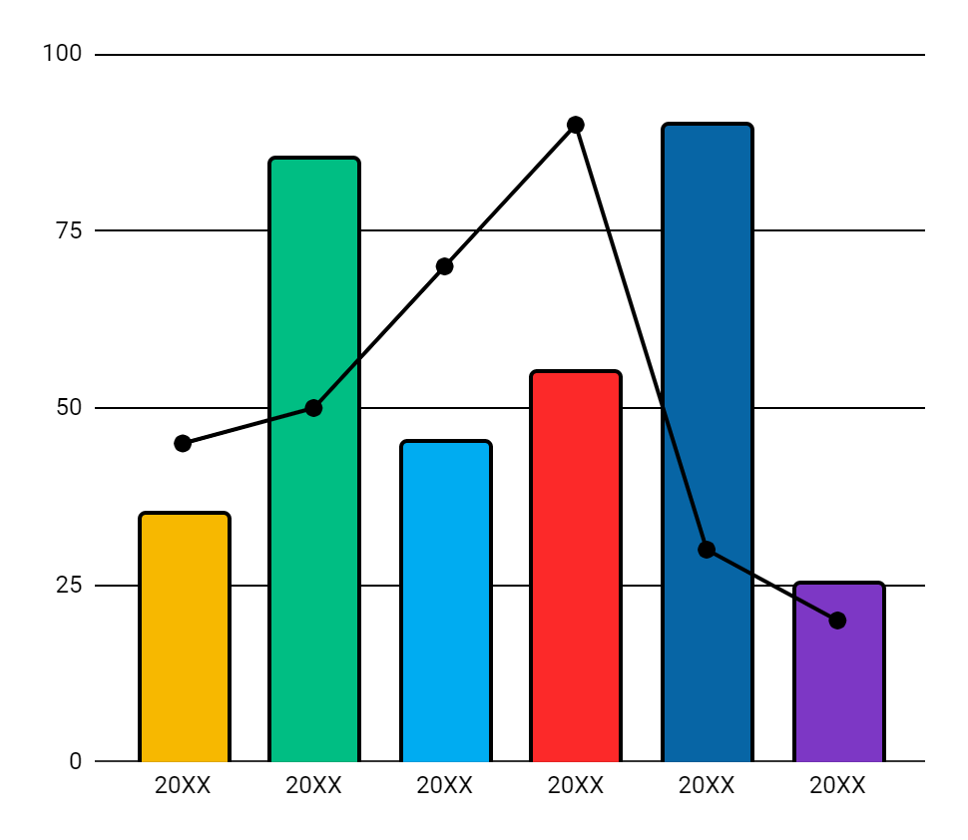
Cybersecurity consulting report infographics
Annual cybersecurity report
Mercury
Jupiter
20XX
It’s the closest planet to the Sun
Jupiter is an enormous planet
20XX
Earth
Venus
20XX
Earth is a planet that has life
Venus has a beautiful name
20XX
Mars
Saturn
20XX
Despite being red, Mars is cold
It’s a gas giant with several rings
20XX
Follow the link in the graph to modify its data and then paste the new one here. For more info, click here
This template has been created by Slidesgo

Slide 41
Cybersecurity consulting report infographics
Good practices to protect your equipment
Use strong passwords
Shop on trusted websites
Venus has a beautiful name, but also very high temperatures
Despite being red, Mars is actually a very cold place
Use secure payments
Use trusted networks
Mercury is the closest planet to the Sun and the smallest of them all
Jupiter is a gas giant and the biggest planet of them all
Beware of spam email
Beware of suspicious links
Earth is the third planet from the Sun and harbors life
Saturn is composed mostly of hydrogen and helium
This template has been created by Slidesgo

Slide 42
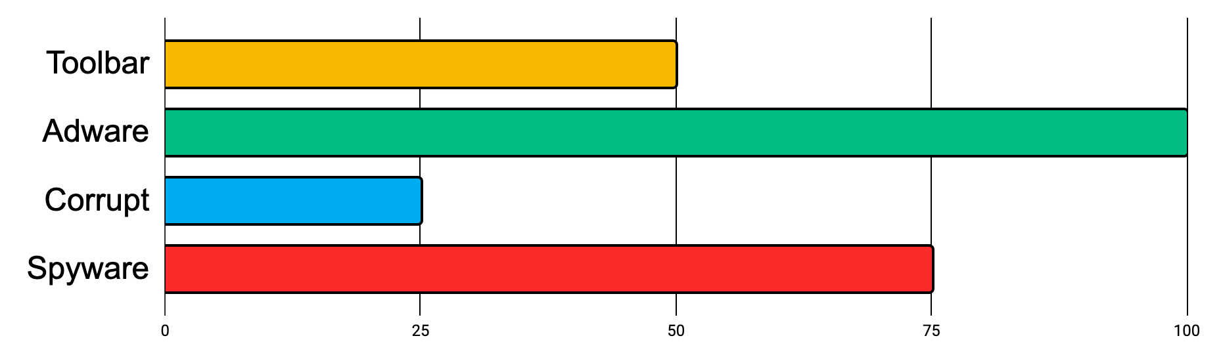
Cybersecurity consulting report infographics
Cybersecurity dashboard
Some risks & software patches
Top 4 threats
OS support
Services
Software
30%
75%
50%
Definitions
AV service
OS patches
Threats & average threats
90%
25%
75%
Threats
1,000
Average threats
1.75 per day
This template has been created by Slidesgo

Slide 43
Cybersecurity consulting report infographics
Cyberattacks around the world
Live attacks
Time | Type | Target
XX | Attack type | Place
XX | Attack type | Place
XX | Attack type | Place
XX | Attack type | Place
XX | Attack type | Place
XX | Attack type | Place
Origin
Objective
Direction
This template has been created by Slidesgo

Slide 44
Cybersecurity consulting report infographics
Risk evaluation matrix: severity of consequences
Frequency of infection | Very low severity | Low severity | Medium severity | High severity | Very high severity
Very high
High
Medium
Low
Very low
Extremely low
Write here
Write here
Write here
Write here
Write here
Write here
This template has been created by Slidesgo

Slide 45
Icon pack
This template has been created by Slidesgo

Slide 46
Instructions for use
If you have a free account, in order to use this template, you must credit Slidesgo in your final presentation. Please refer to the next slide to read the instructions for premium users.
As a Free user, you are allowed to:
- Modify this template.
- Use it for both personal and commercial projects.
You are not allowed to:
- Sublicense, sell or rent any of Slidesgo Content (or a modified version of Slidesgo Content).
- Distribute Slidesgo Content unless it has been expressly authorized by Slidesgo.
- Include Slidesgo Content in an online or offline database or file.
- Offer Slidesgo templates (or modified versions of Slidesgo templates) for download.
- Acquire the copyright of Slidesgo Content.
For more information about editing slides, please read our FAQs or visit our blog:
https://slidesgo.com/faqs and https://slidesgo.com/slidesgo-school

Slide 47
Instructions for use (premium users)
As a Premium user, you can use this template without attributing Slidesgo.
You are allowed to:
Modify this template.
Use it for both personal and commercial purposes.
Share this template in an editable format with people who are not part of your team.
You are not allowed to:
Sublicense, sell or rent this Slidesgo Template (or a modified version of this Slidesgo Template).
Distribute this Slidesgo Template (or a modified version of this Slidesgo Template) or include it in a database or in any other product or service that offers downloadable images, icons or presentations that may be subject to distribution or resale.
Use any of the elements that are part of this Slidesgo Template in an isolated and separated way from this Template.
Register any of the elements that are part of this template as a trademark or logo, or register it as a work in an intellectual property registry or similar.
For more information about editing slides, please read our FAQs or visit our blog:
https://slidesgo.com/faqs and https://slidesgo.com/slidesgo-school

Slide 48
Infographics
You can add and edit some infographics to your presentation to present your data in a visual way.
Choose your favourite infographic and insert it in your presentation using Ctrl C + Ctrl V or Cmd C + Cmd V in Mac.
Select one of the parts and ungroup it by right-clicking and choosing “Ungroup”.
Change the color by clicking on the paint bucket.
Then resize the element by clicking and dragging one of the square-shaped points of its bounding box (the cursor should look like a double-headed arrow). Remember to hold Shift while dragging to keep the proportions.
Group the elements again by selecting them, right-clicking and choosing “Group”.
Repeat the steps above with the other parts and when you’re done editing, copy the end result and paste it into your presentation.
Remember to choose the “Keep source formatting” option so that it keeps the design. For more info, please visit our blog.

